Slide 1
CEIS106 COURSE PROJECT OPERATING SYSTEMS
Presented by: Deven Williams

Slide 2
INTRODUCTION
Add your first bullet point here
Add your second bullet point here
Add your third bullet point here

Slide 3
Linux Filesystem Hierarchy
Add your first bullet point here
Add your second bullet point here
Add your third bullet point here

Slide 4
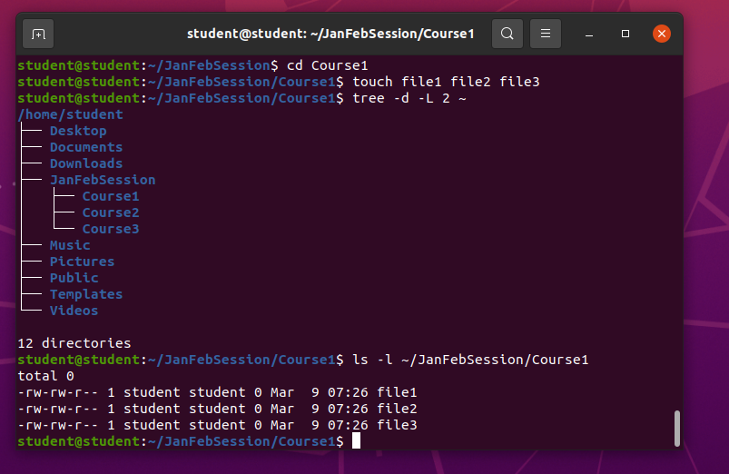
Create directories and files
.

Slide 5
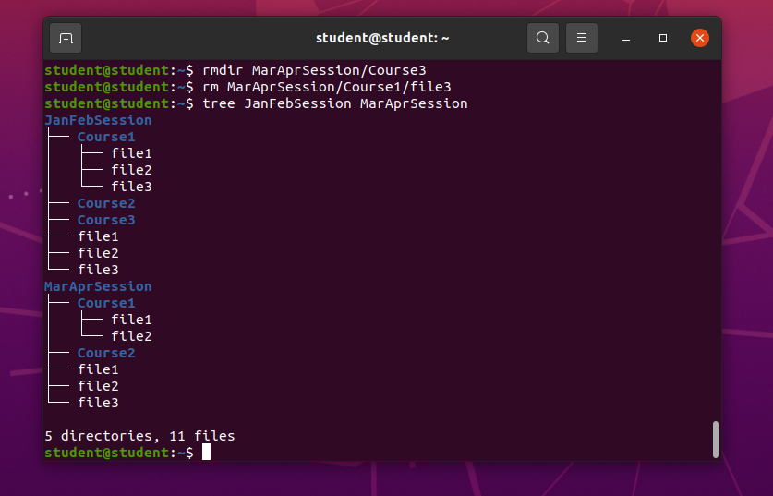
Copy and remove directories and files

Slide 6
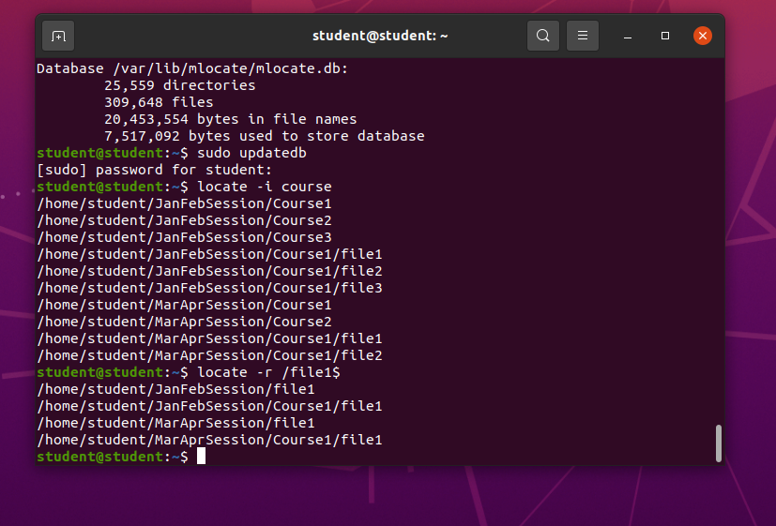
Locate directories and files

Slide 7
Linux Shell Scripts
Add your first bullet point here
Add your second bullet point here
Add your third bullet point here

Slide 8
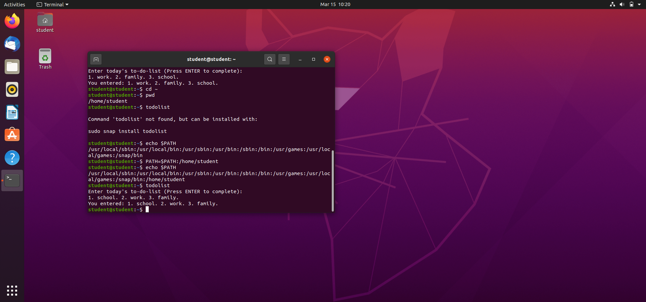
Set the PATH variable

Slide 9
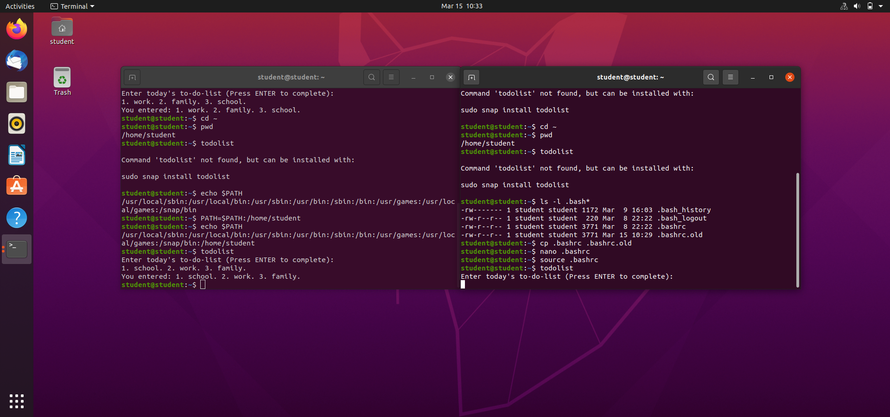
Make the PATH variable permanent

Slide 10
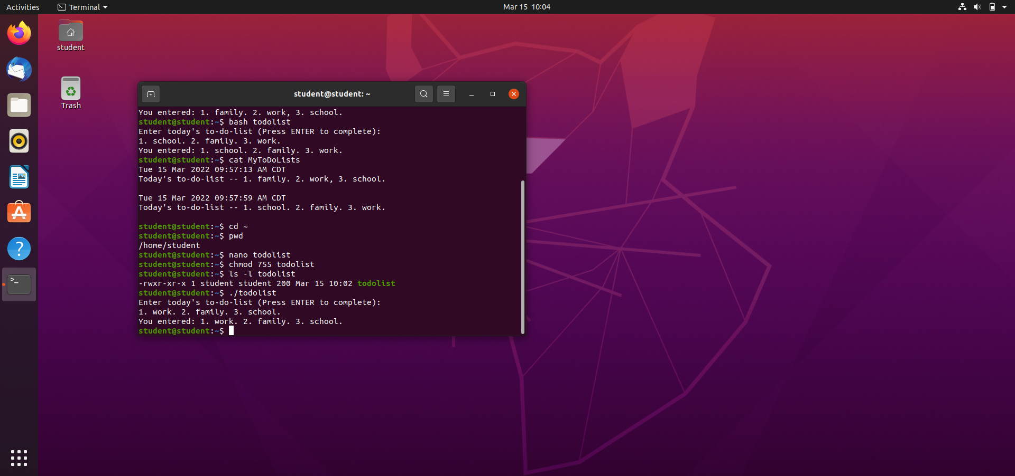
Change script file permissions

Slide 11
User and Group Management
Add your first bullet point here
Add your second bullet point here
Add your third bullet point here

Slide 12
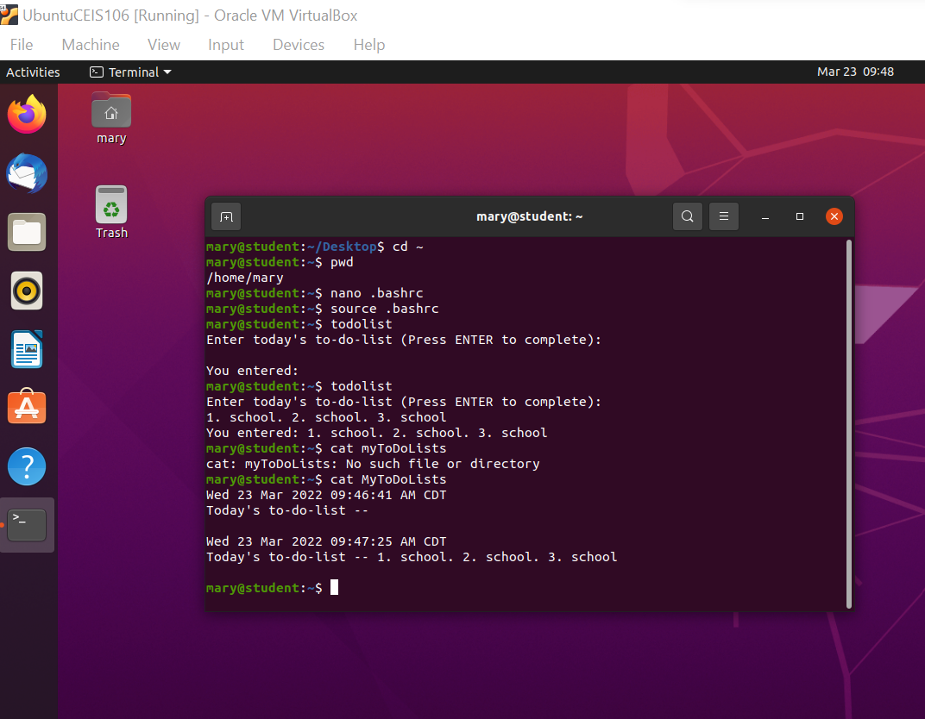
Test user and group settings

Slide 13
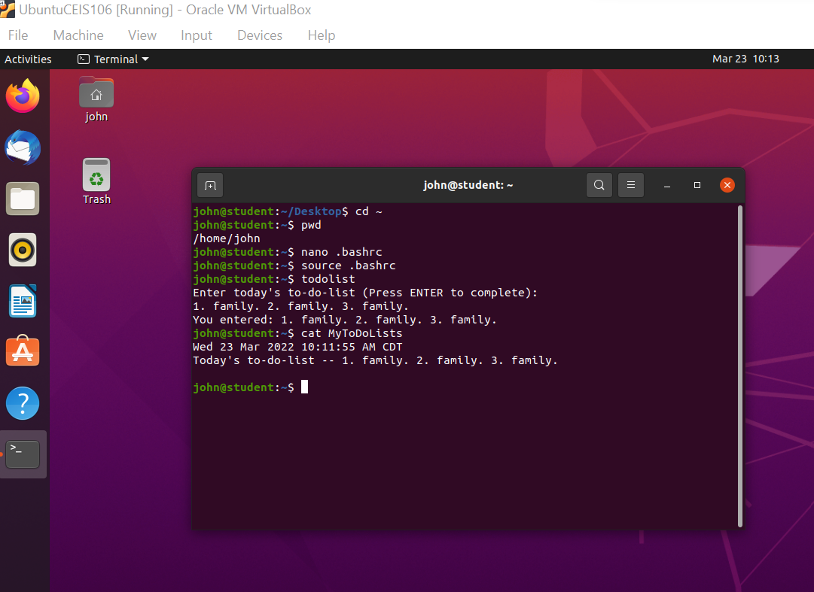
Add users in GUI

Slide 14
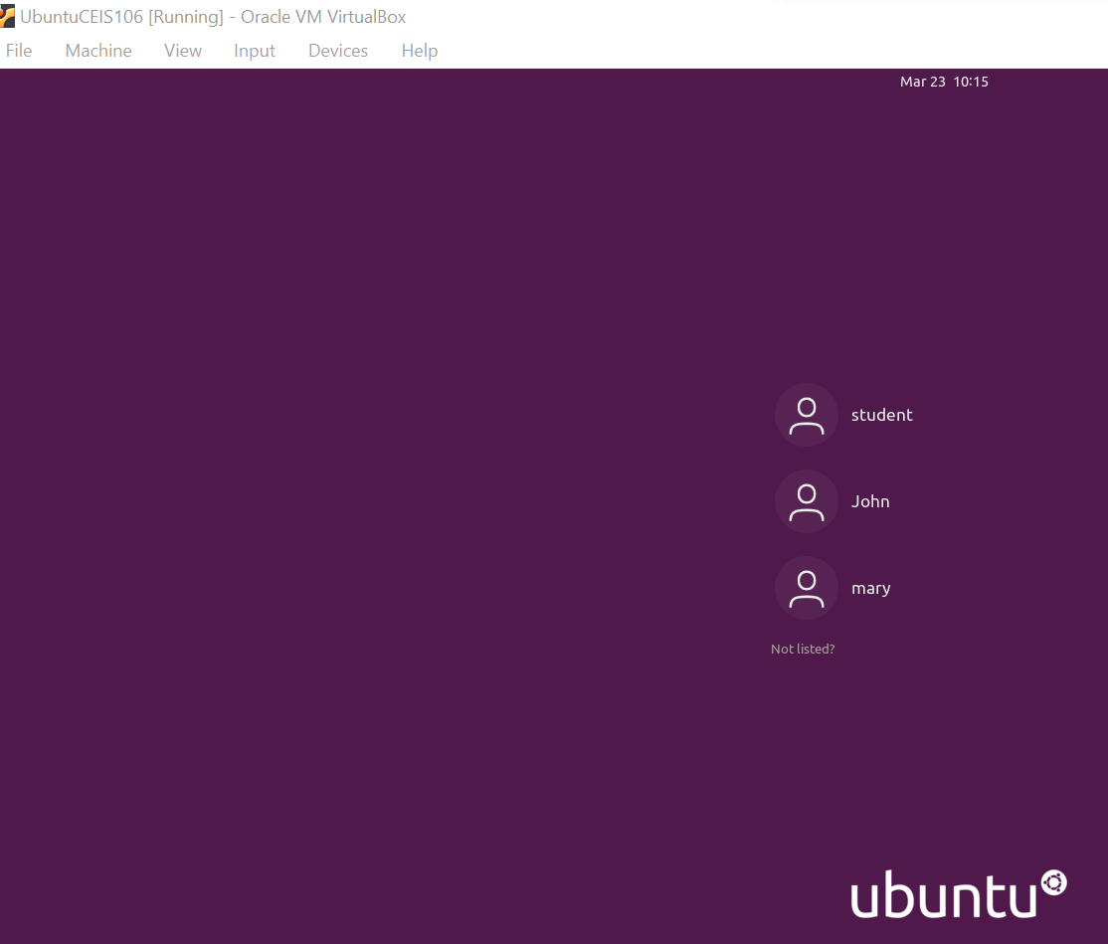
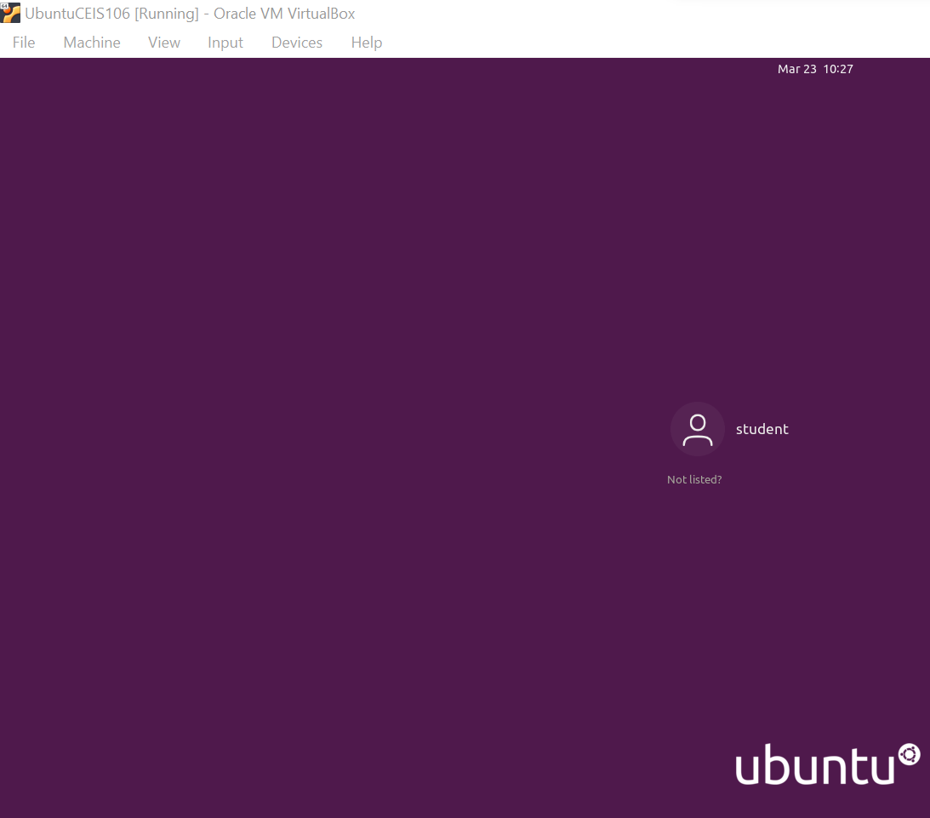
Remove users and groups

Slide 15
Network Configuration
Add your first bullet point here
Add your second bullet point here
Add your third bullet point here

Slide 16
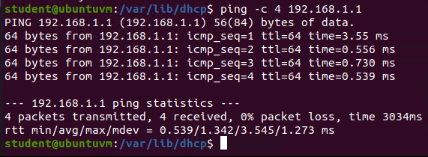
Discover host IP configurations
Step 6 Output

Slide 17
Manage network interfaces

Slide 18
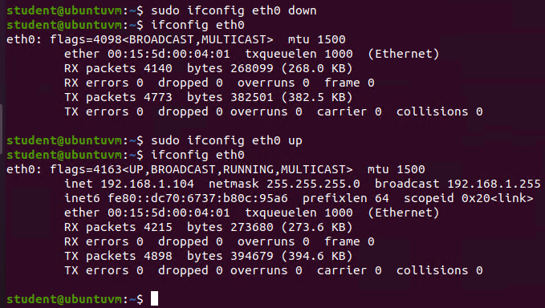
Use network utilities
Step 5 Output

Slide 19
System Performance Monitoring
Add your first bullet point here
Add your second bullet point here
Add your third bullet point here

Slide 20
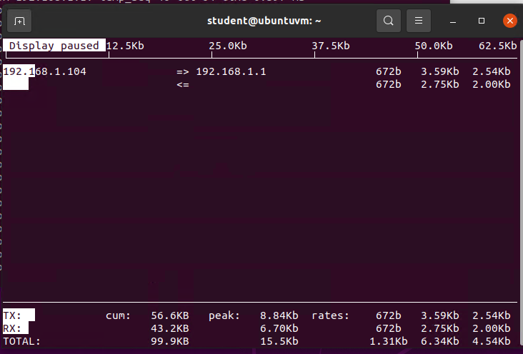
Monitor network bandwidth usage

Slide 21
CHALLENGES
Add your first bullet point here
Add your second bullet point here
Add your third bullet point here

Slide 22
CAREER SKILLS ACQUIRED
Add your first bullet point here
Add your second bullet point here
Add your third bullet point here

Slide 23
CONCLUSION

